Slide 1
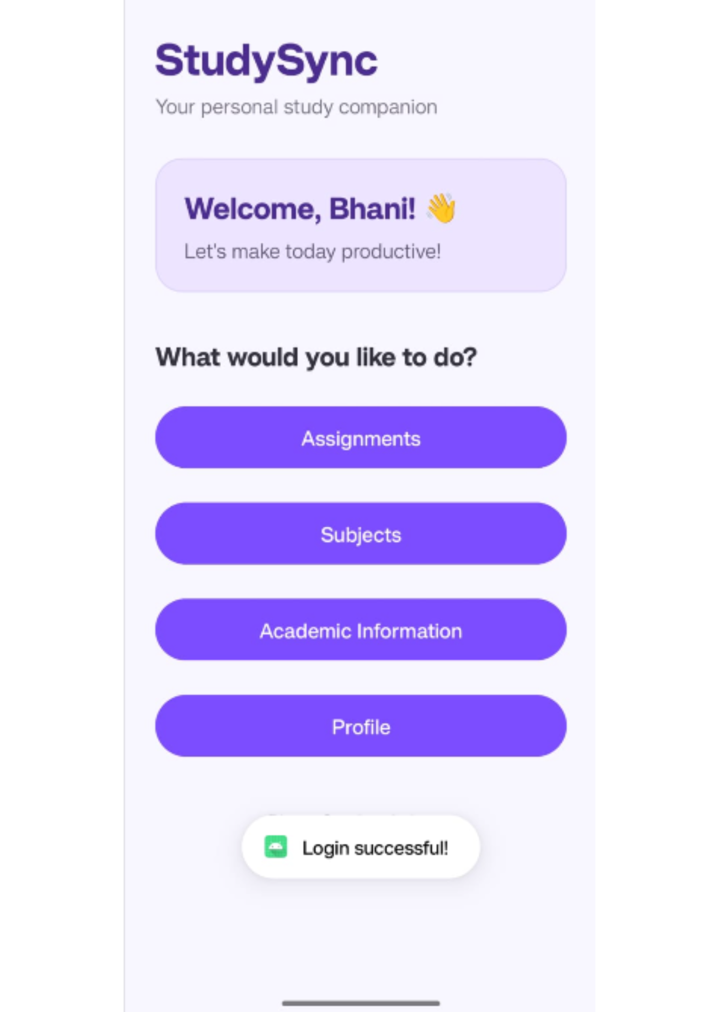
STUDYSYNC
Mobile Application Development Project
StudySync
Student Academic & Assignment Management System
Presented by Bhani Malhotra and Nikita Sharma
Java • XML • SQLite

Slide 2
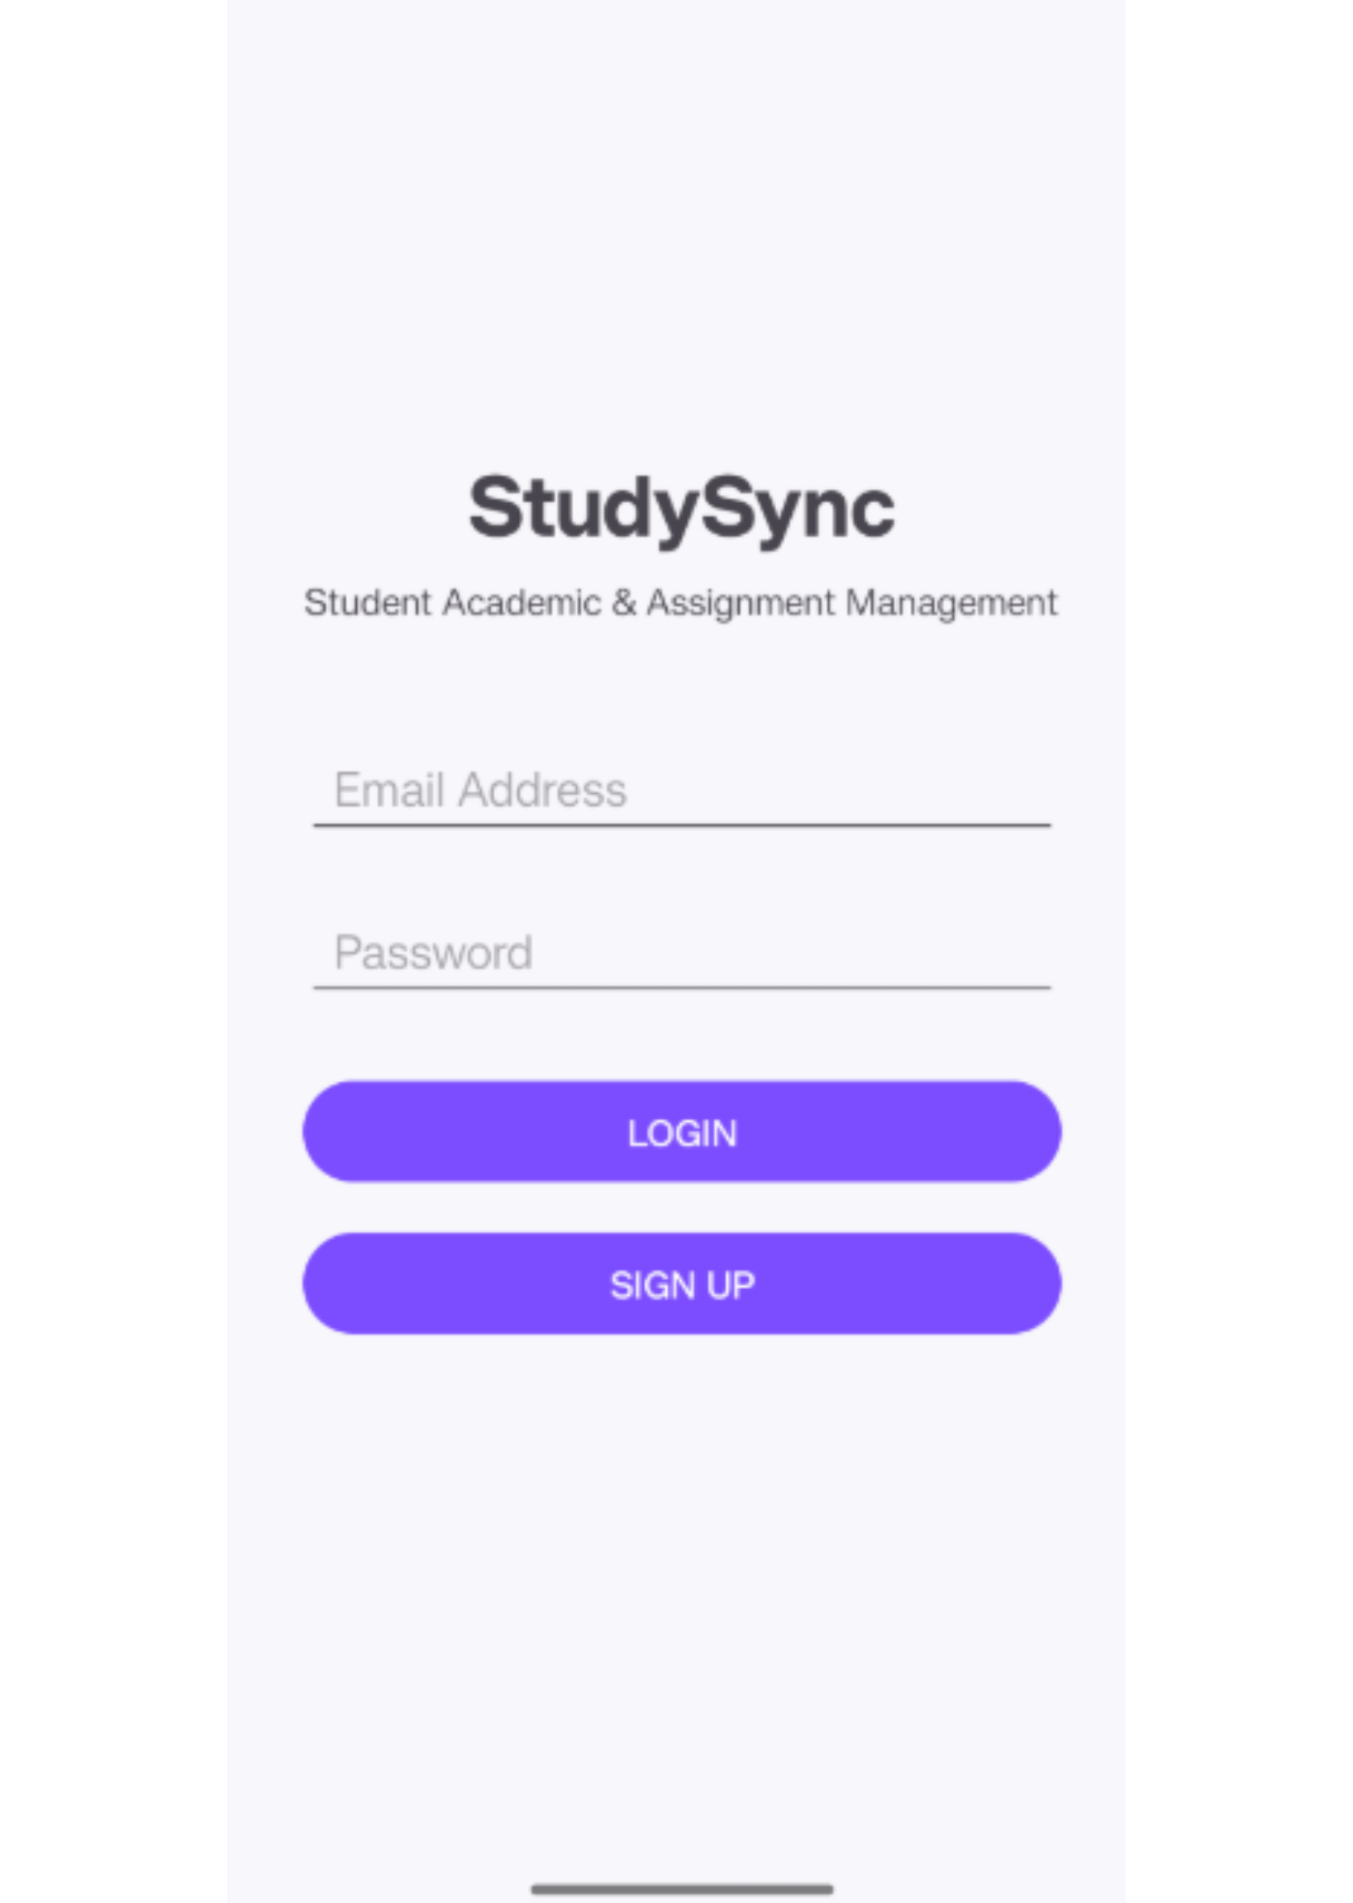



01
The problem
Students need one place to manage academic life
Deadlines, subjects, attendance, grades, and profile details are often tracked separately.
That makes pending work and academic progress harder to monitor.
StudySync brings these activities into one centralized Android application.

Slide 3
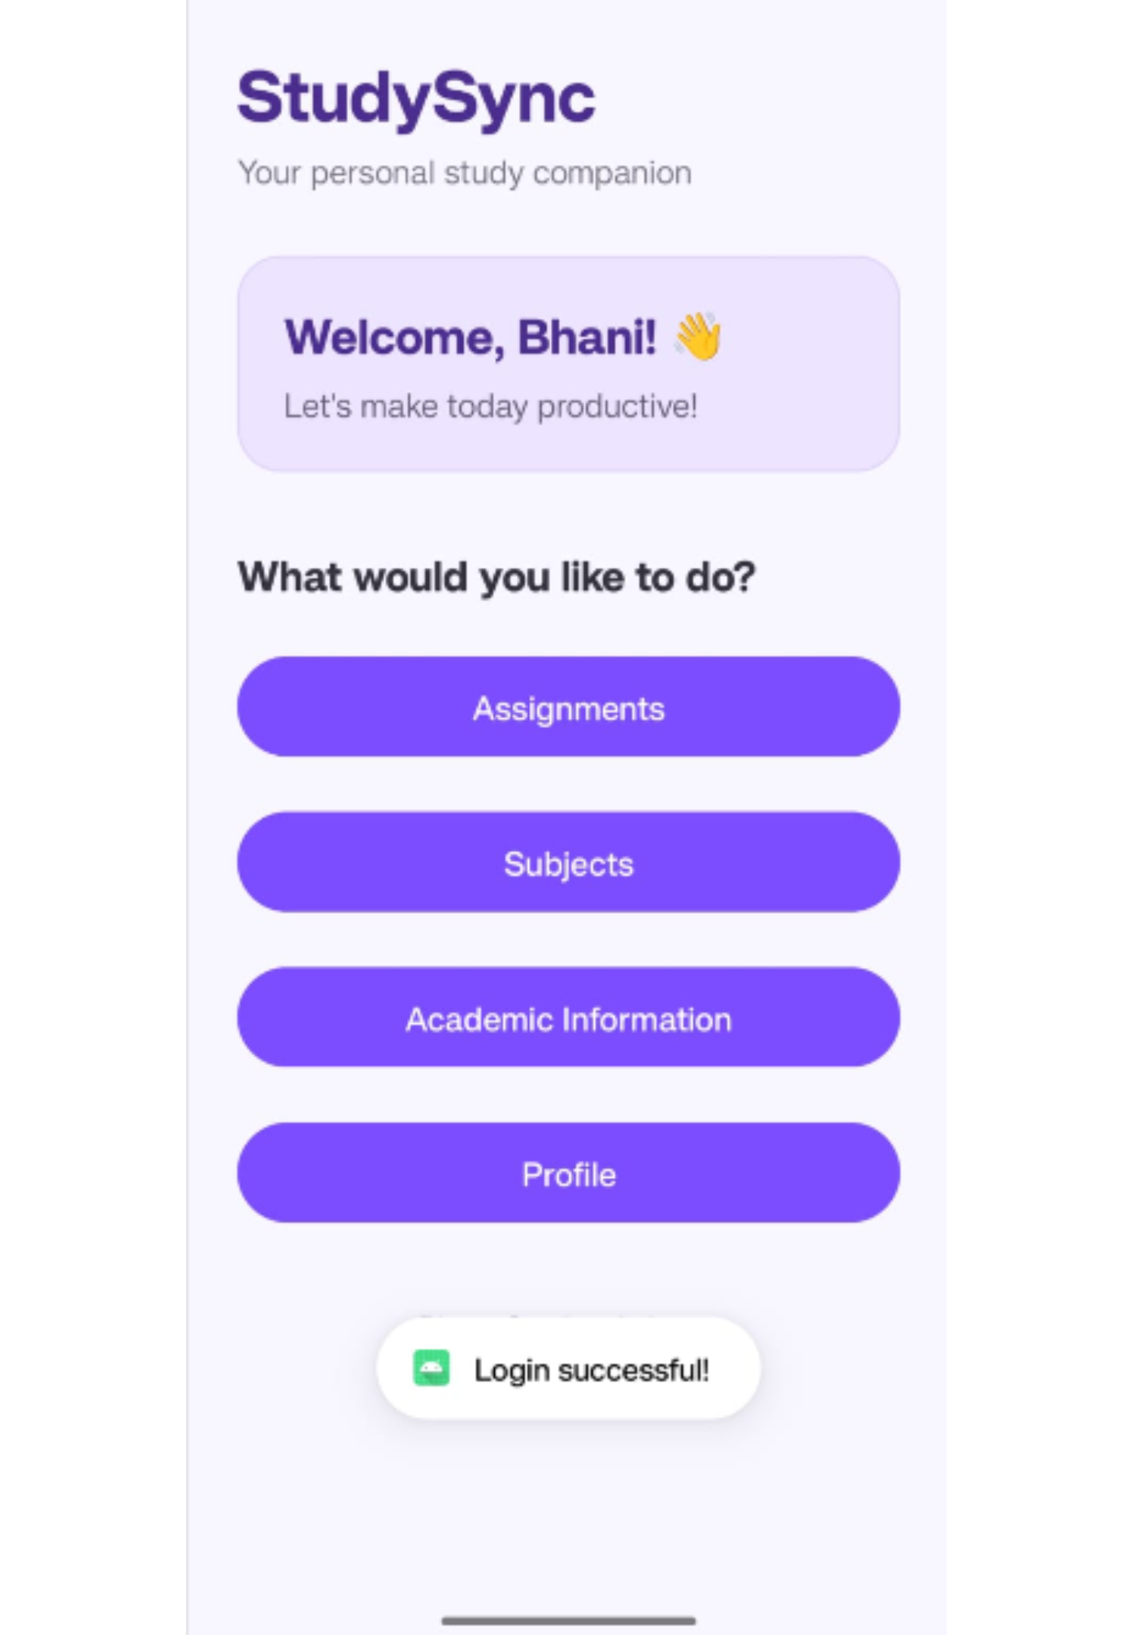
02
What StudySync does
StudySync turns scattered tasks into a manageable routine
Secure registration and login
Create, update, view, and delete assignments
Organize semester-wise subjects
Track credits, grades, GPA, CGPA, attendance, and marks
Manage profile and account details

Slide 4
03
Architecture
Five technologies support a simple local-first architecture
Technology | Role
Android Studio | Development and testing environment
Java | Application logic, calculations, and validation
XML | User interface layouts
SQLite | Local storage for users, subjects, assignments, and results
SharedPreferences | Login-session management
Workflow: Student → Android UI → Java activities → SQLite database

Slide 5




04
Access and navigation
Login opens a personalized academic dashboard
Register
Log in
Students create an account.
Email and password are checked against stored account information.
Dashboard
Choose a module
The student receives a personalized academic view.
Assignments, Subjects, Academic Information, and Profile.

Slide 6
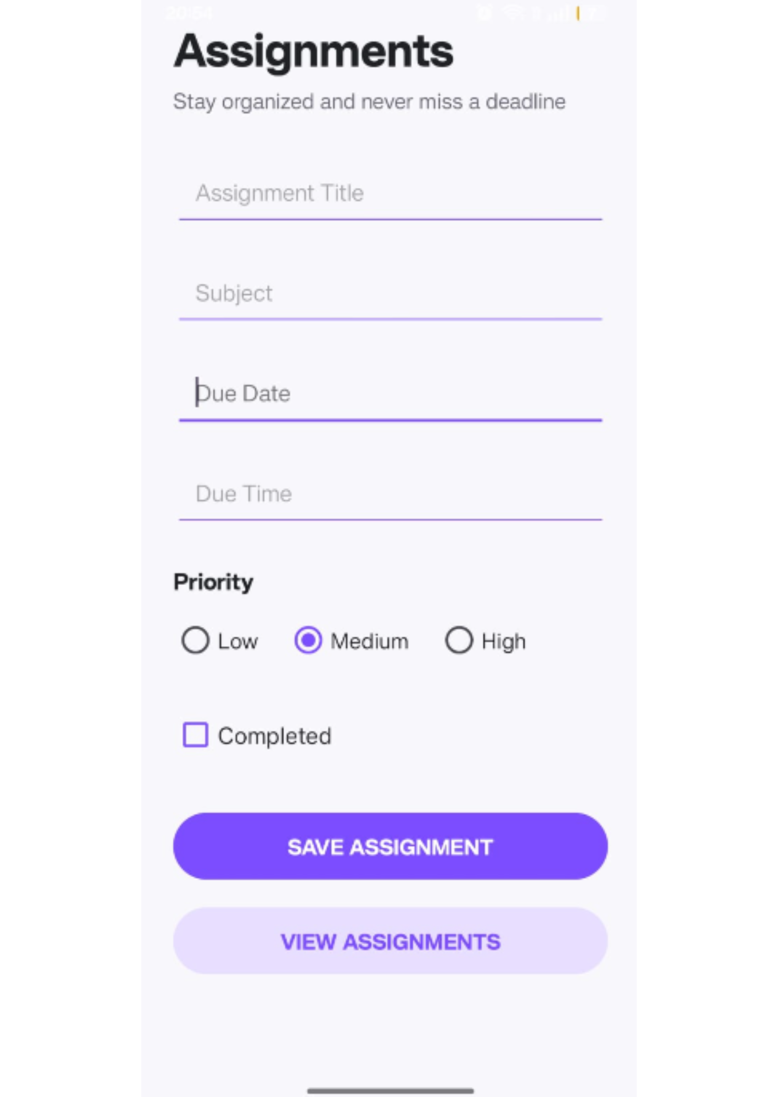
05
Assignments
Assignment management makes deadlines visible
Create
Prioritize
Create assignments with a title, subject, due date, and time.
Set low, medium, or high priority and mark work complete.
Track
Maintain
Saved assignments appear as readable cards with deadlines and status.
Existing assignments can be edited or deleted.
Visual focus: assignment creation form beside priority-based tracking.

Slide 7
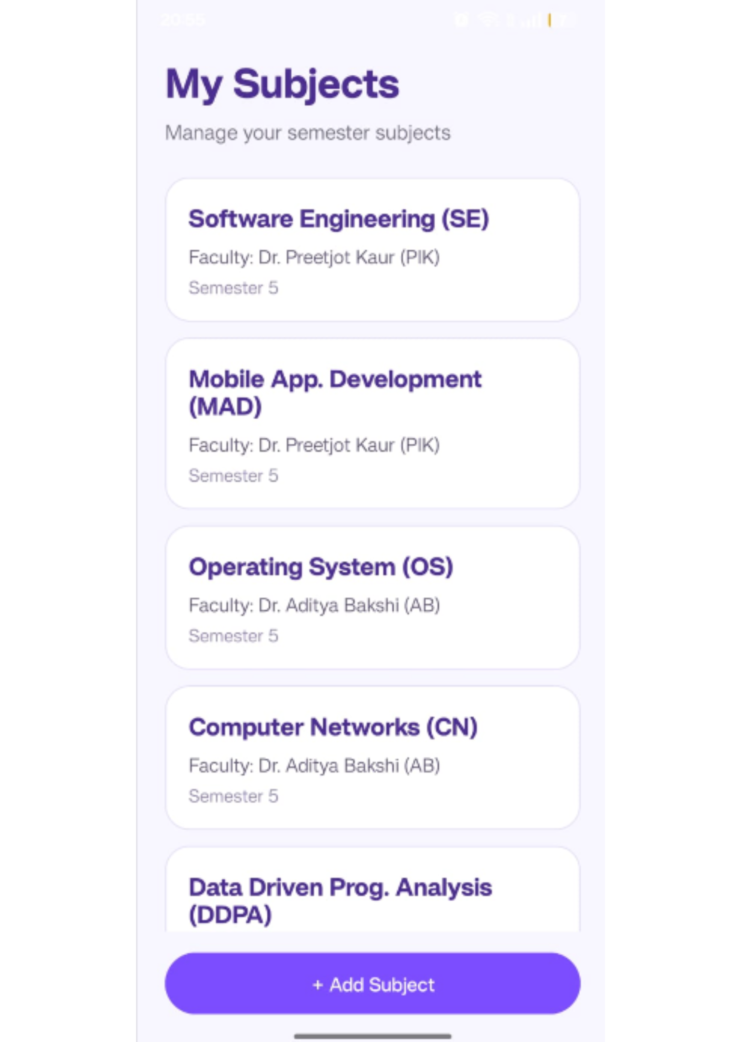
06
Subjects
Subject management keeps semester information organized
Record | What it stores | How it is used
Subject | Subject names and faculty details | Maintained in SQLite
Semester | Semester numbers | Configured for Semester 1–5
Academic entry | Selected subject record | Source for academic-information entry
Add, edit, or delete subject records as semester information changes.

Slide 8
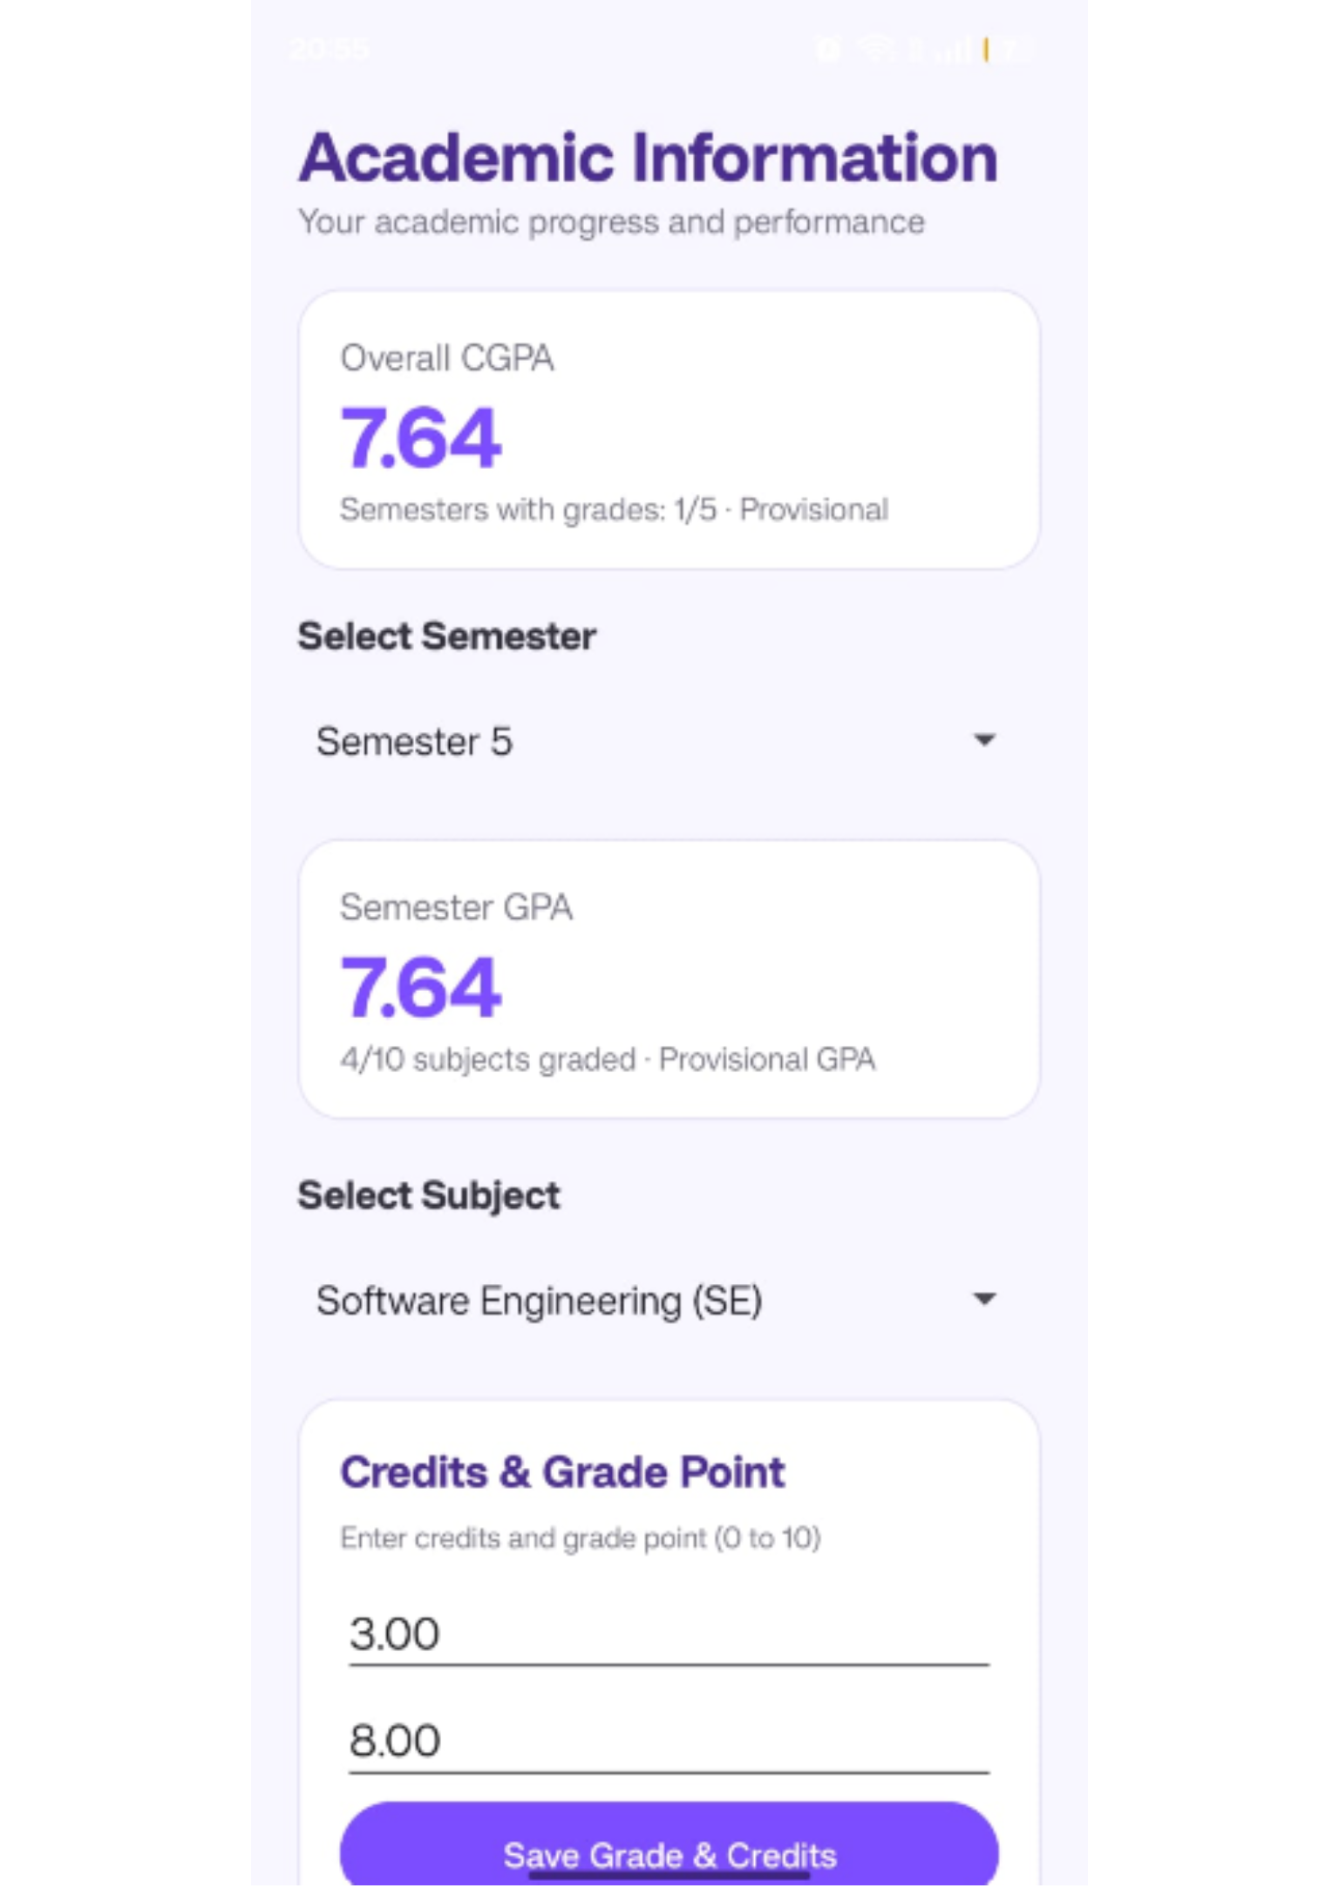
07
Academic information
Credit-weighted results make GPA and CGPA easy to follow
Select a semester and subject, then enter credits and grade points.
7.64
7.64
GPA
CGPA
Semester result using credit-weighted grade points.
Overall weighted result across recorded semesters.
Provisional results update as grades are added.

Slide 9
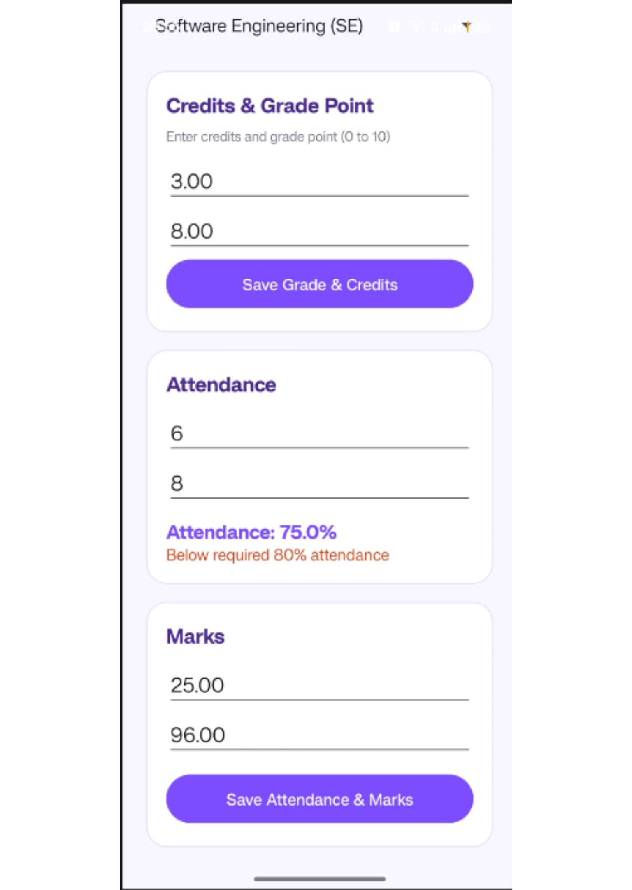
08
Academic risk
Attendance and marks expose academic risk early
75%
80%
Attendance example
Requirement
6 of 8 classes attended.
Below-required warning is triggered.
Marks stay separate
Internal and external marks are stored separately for each subject.
Attendance percentage = attended classes ÷ total classes × 100.

Slide 10
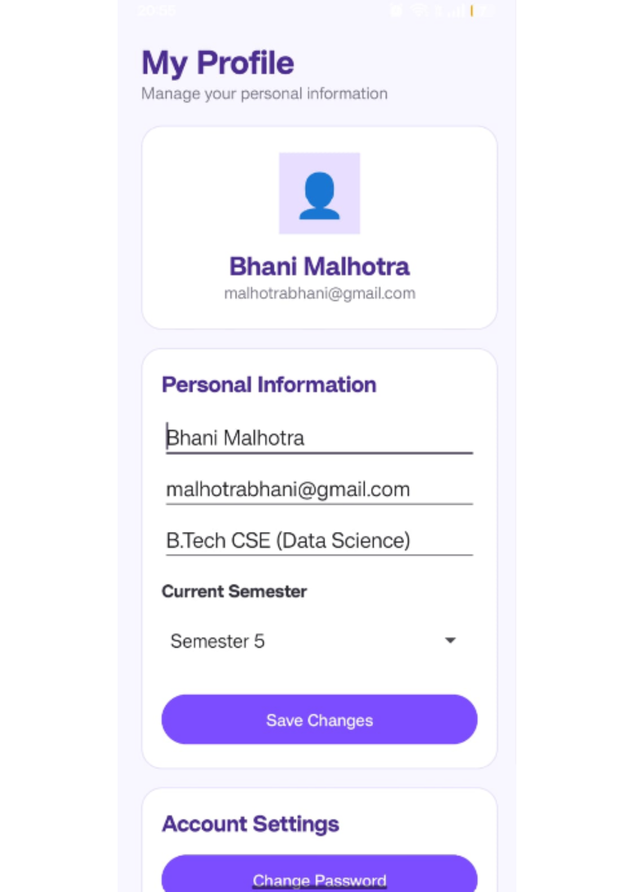


09
Profile and account
The profile module keeps student details under control
View and edit name, email, course, and current semester.
Save updated profile information to the local database.
Change the account password or log out without deleting academic records.
Academic records stay safe while account details stay current.
→
Conclusion
Future scope
One local-first Android app for academic records.
Cloud sync, deadline reminders, and richer reports.

Slide 11


